Slide 1

Interior On You (IOU)
Team O8O
4 week presentation

Slide 2


Feedback
System Presentation
Schedule change
What we do?
What we will do?
content

Slide 3
Feedback
Mentor`s Feedback
Q. How can scoring user`s interior image?
Q. How can delete user`s furniture in image?
Recommend for voting system at SNS.

Slide 4


Feedback
Q. SNS and feature seems more suitable for Mobile.

Slide 5

Feedback
Q. How can 360 degree image construct with image?

Slide 6
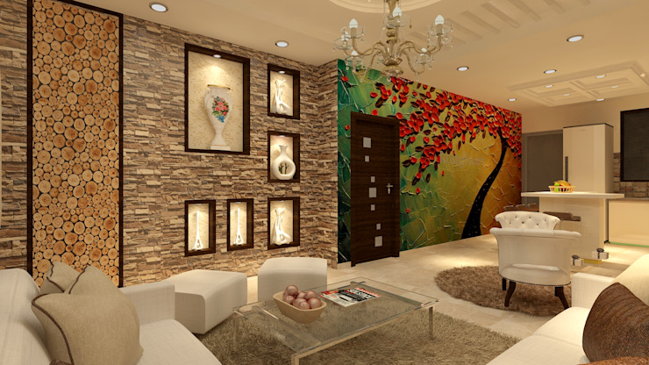
Feedback
Q. How will be feature made up?

Slide 7
Feedback
Q. How will be feature made up?

Slide 8
Feedback
Q. How will be feature made up?

Slide 9
Feedback
Q. How will system be constructed?
Q. Which technology will be used?

Slide 10



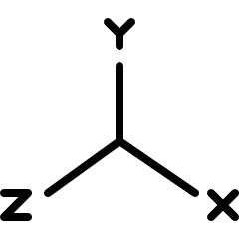




System Presentation

Slide 11
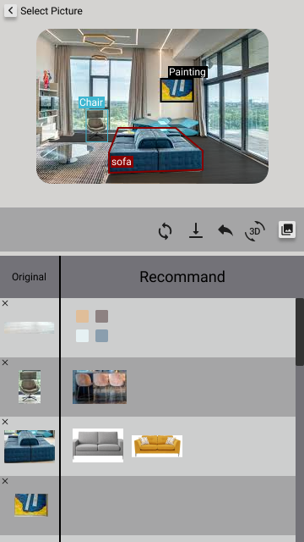
System Presentation

Slide 12
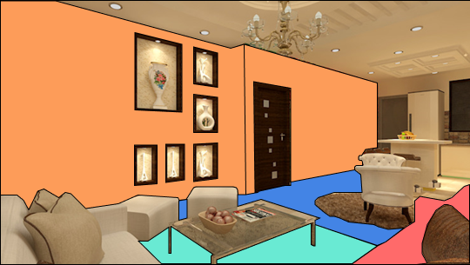
System Presentation
Q. Which technology will be used?
Image Segmentation

Slide 13
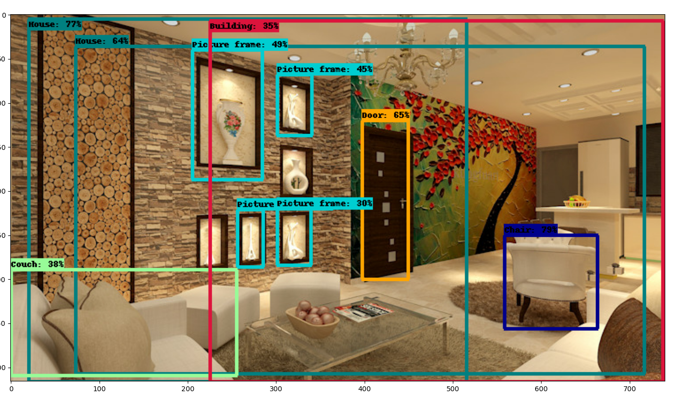
System Presentation
Q. Which technology will be used?
Object Detecting

Slide 14
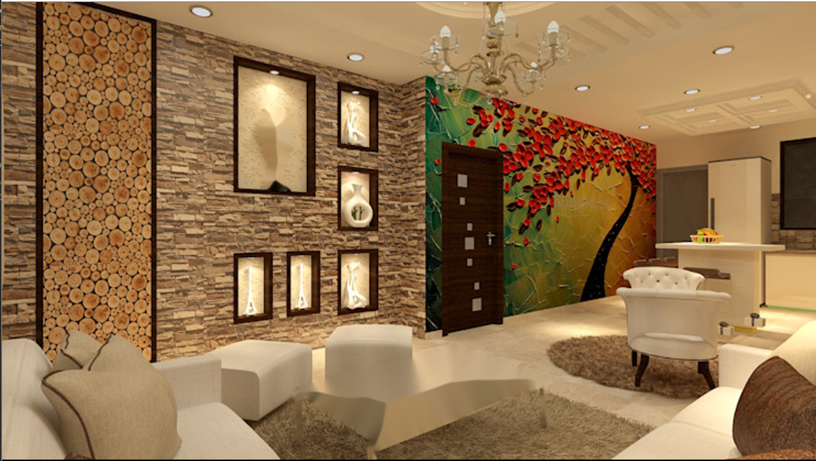
System Presentation
Q. Which technology will be used?
Image Inpainting

Slide 15
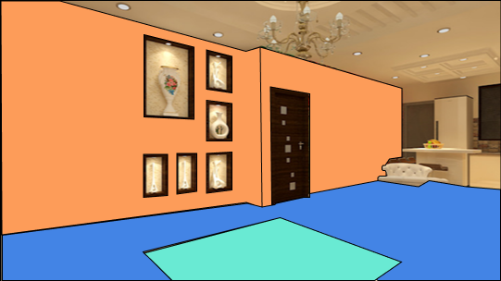

System Presentation
Q. Which technology will be used?
With User Input

Slide 16
System Presentation
Q. What about distorted furniture?

Slide 17
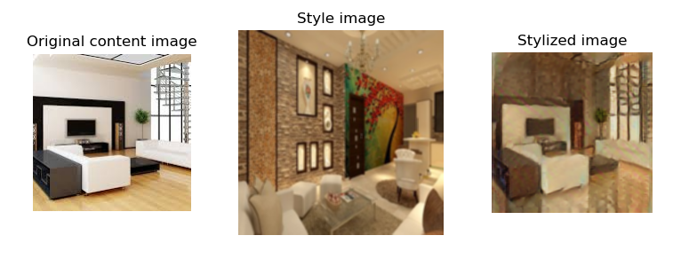


System Presentation
Q. What about unbeseeming furniture?

Slide 18
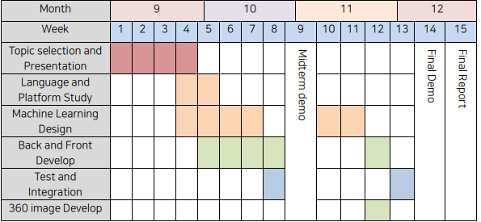
Schedule change
Group Schedule

Slide 19
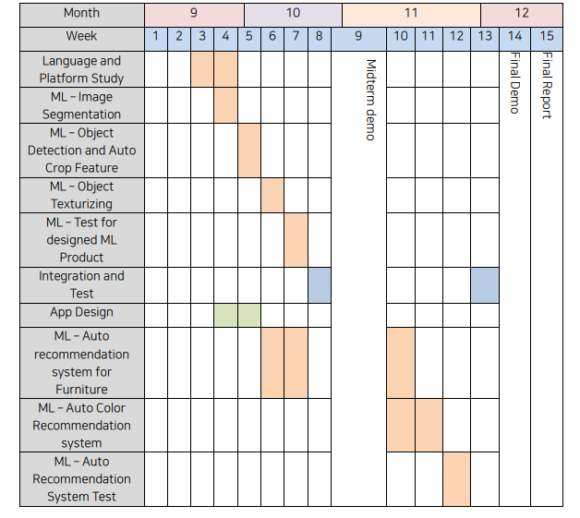
Schedule change
최현준 Schedule

Slide 20
What we do?
App Screen Specify.
DB Schema design.
Study HTML, css and js for Front-end develop.
Search API and Lecture for develop system.

Slide 21
What we do?
App Screen Specify
Login
Main
SNS
Interior Change

Slide 22
What we do?
App Steps
Preference Research
Image Upload
Login
Modify Image

Slide 23
What we do?
App Screen Specify

Slide 24
What we do?
DB Schema Design
User
Boards
Image
Features

Slide 25
What we will do?
App UI Design.
Image Segmenting to auto-crop image.
Study for Front-end develop ( react ) and start develop.
Search API and Lecture for develop system.
Feature extract interior image.

Slide 26
Contact Us
Trello : https://trello.com/o8o/home
Github : https://github.com/O8-O
Infor-note : notion1
Meeting-note : notion2

Slide 27
Thank you
Q & A

